Slide 2
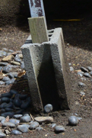
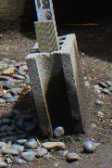
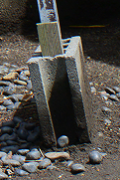
Fig. Illustration of SPA scores for subpixel rendering algorithms
PDAF
score 23.96
DDSD
score 27.10
DDSDMMSE
score 28.98

